Slide 1
EV Moghaddam
Terrell Blackgoat
Miwa Dawidowicz
Austin Engelbrecht
EV Moghaddam 10/6/21

Slide 2
Project Description
Sponsor:
Dr. Hesam Moghaddam
Task:
Design a energy harvesting system that can be added onto an electric vehicle that gathers excess forms of energy to be stored and directed toward the use of another component within the vehicle.
Goal:
Increase performance of vehicle by saving electrical energy that could’ve potentially be lost.
EV Moghaddam 10/6/21
Notes:
Provide a brief but meaningful review / description of the project as a review
Present your Functional decomposition (Black Box model and then detailed decomposition model of your team’s choice) and discuss how it helped in your Concept Generation process.

Slide 3
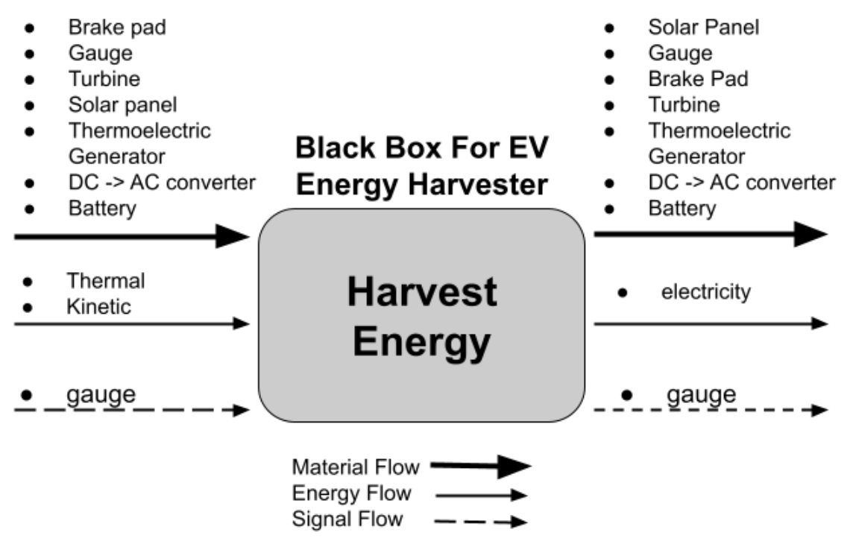
Black Box Model
EV Moghaddam 10/6/21

Slide 4
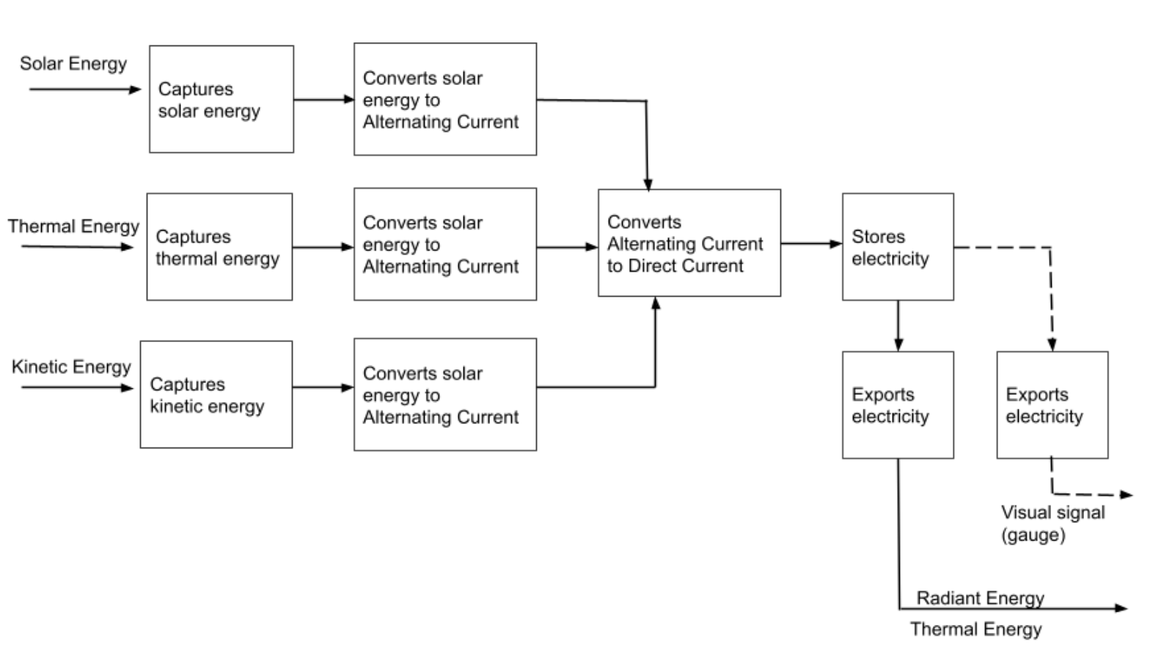
Functional Decomposition Model
EV Moghaddam 10/6/21

Slide 5
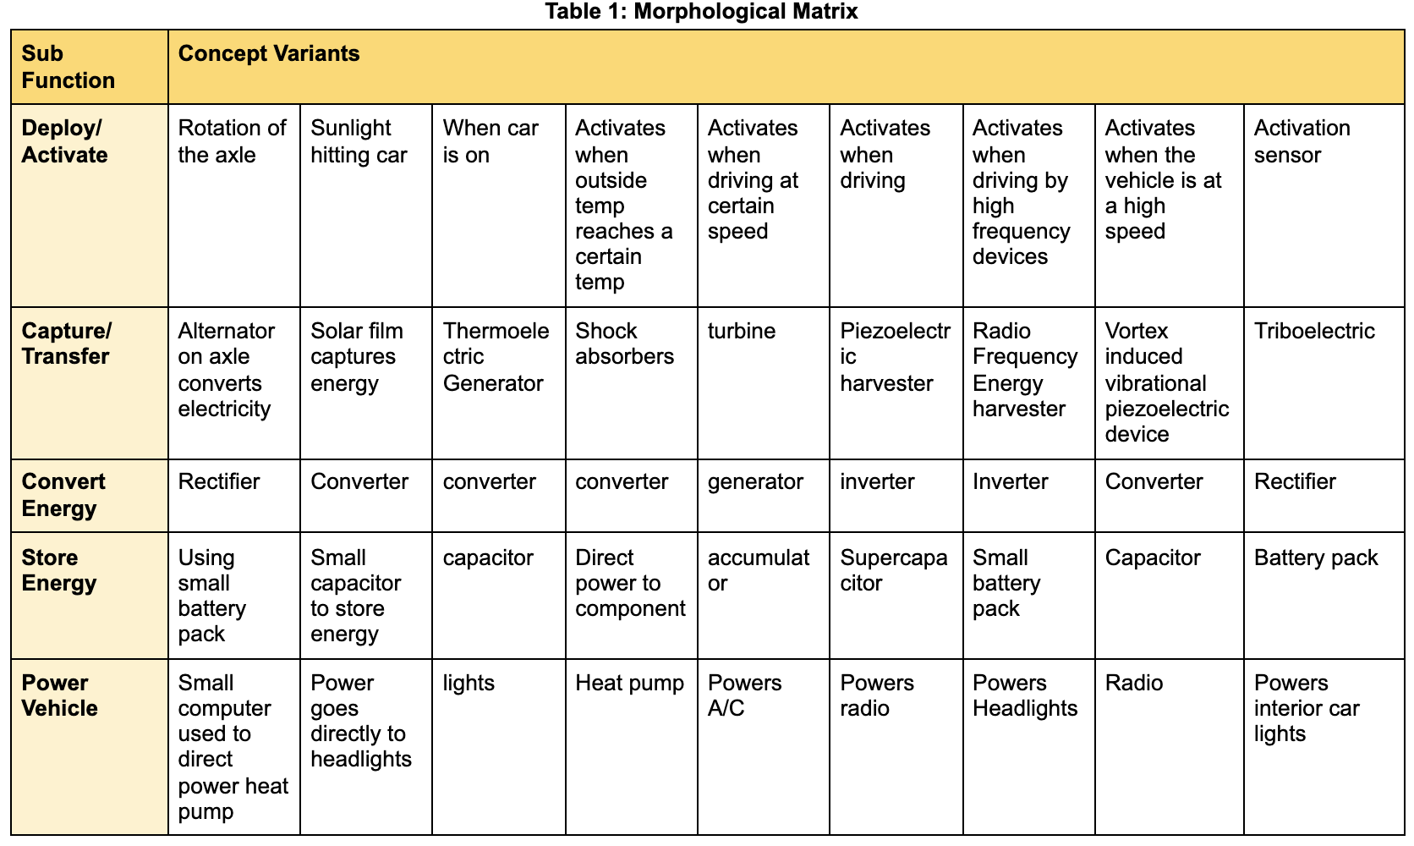
Concept Generation - Morphological Matrix
EV Moghaddam 10/6/21

Slide 6
Concept Generation - Design Alternatives
Decided each team member would come up with 2-3 forms of energy generation
Chose different designs based off of the list that had been created allowing for various strengths and weaknesses to be seen with the combinations of different energy harvesting sources
Top 3 designs were: Design 1, Design 3, Design 4
Design elements of note: Radio Frequency generator, Vortex induced vibrational piezoelectric device, piezoelectric device
EV Moghaddam 10/6/21
Notes:
Provide a description of how concepts were generated
Provide an overview of the designs being considered. Do not show all designs, choose a representative sample of the best or most creative.
As space allows, list advantages/disadvantages of each

Slide 7
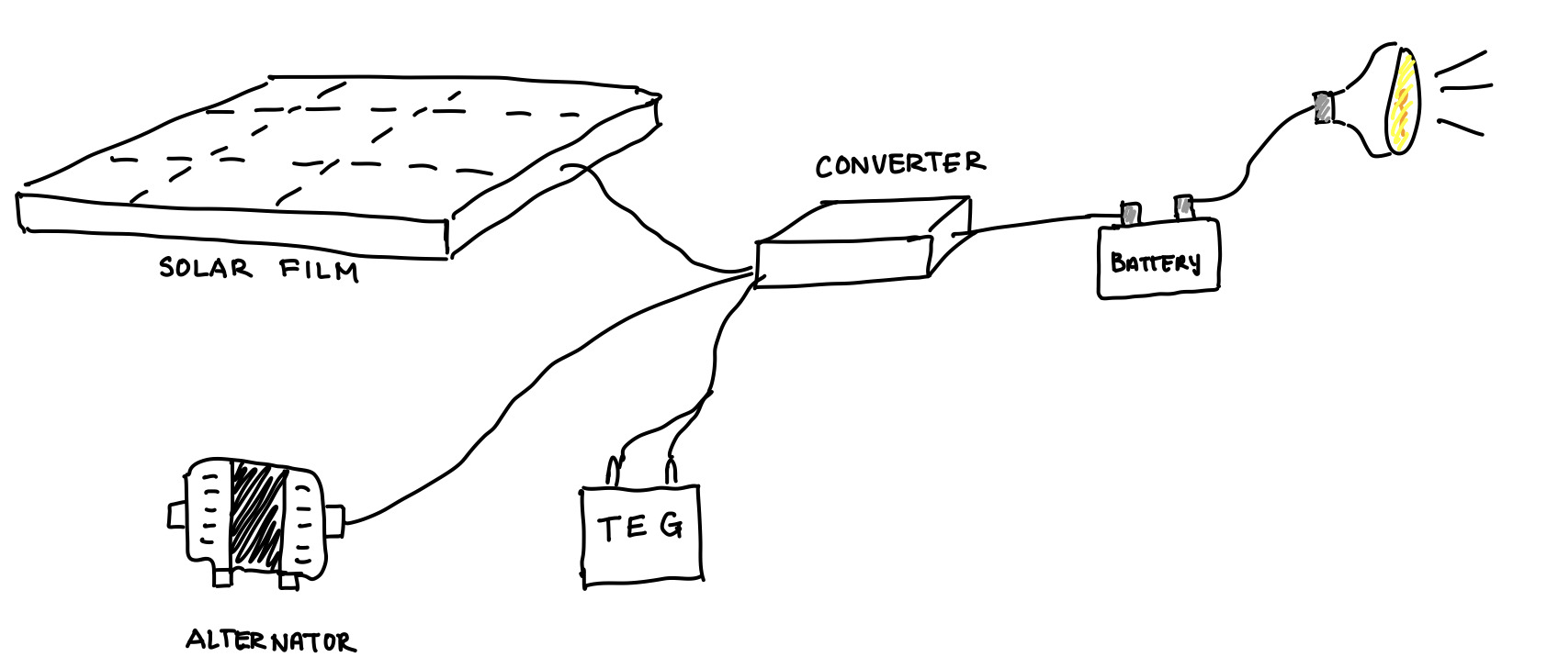
Design 1
Advantages: Power generation, ease of material gathering, mechanical component makes repair easier, in the midrange of price
Disadvantages: Difficult to implement onto vehicle, not the most mechanically sound design
Figure 1: Visual of Design 1 which consists of a thermoelectric generator, alternator, solar film, converter, battery, and powers the headlights
EV Moghaddam 10/6/21

Slide 8
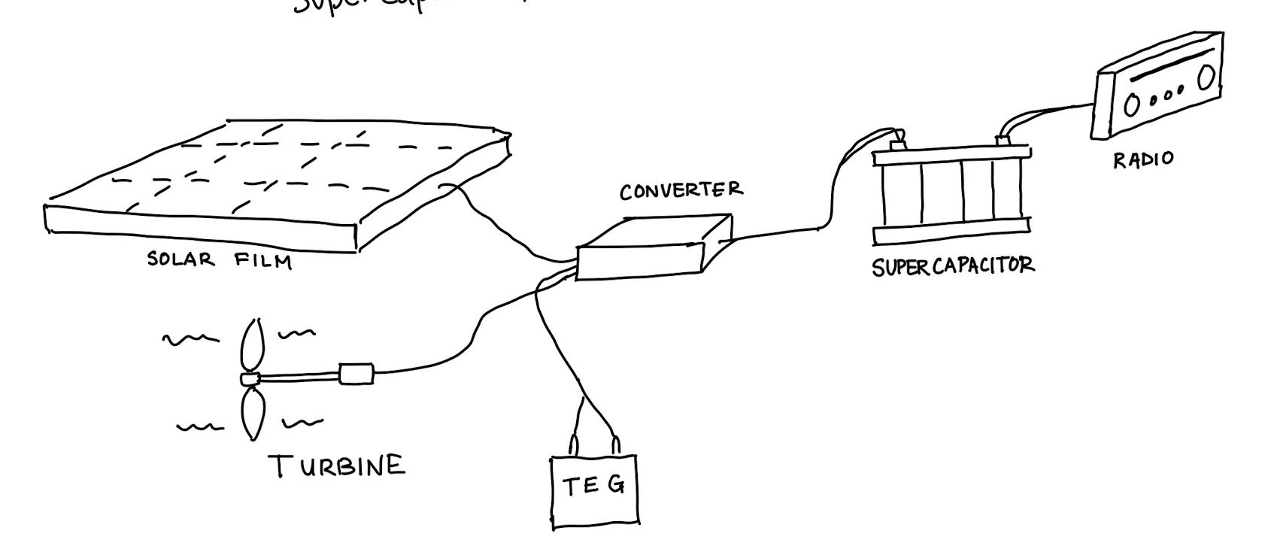
Design 3
Advantages: Has high energy generation capabilities, Design would be easy apply
Disadvantages: Very difficult to implement without ruining aesthetics, Maintenance on turbine would be difficult, expensive to implement
Figure 2: Visual of Design 3 which consists of a turbine, solar film, thermoelectric generator, converter, supercapacitor, and powers the radio
EV Moghaddam 10/6/21

Slide 9
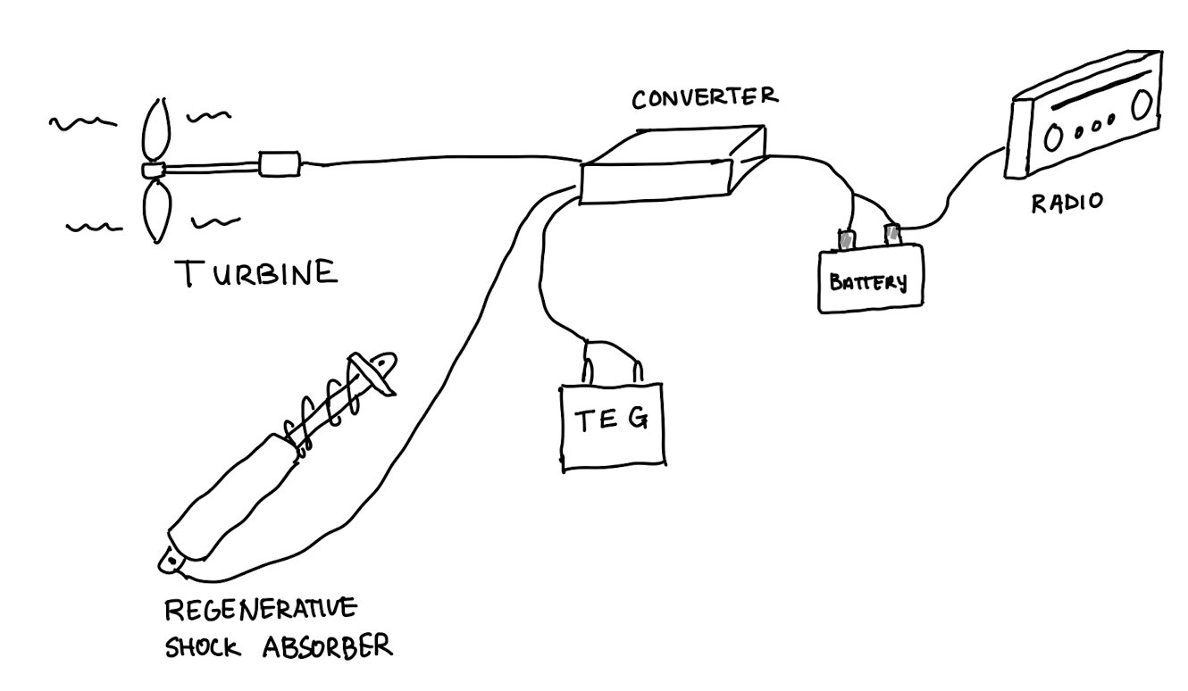
Design 4
Advantages: Power dense design, interesting application of some newer technology, design would allow for simple application of power
Disadvantages: Expensive design, not all elements are readily available on the market, turbine would be aesthetically challenging
Figure 3: Visual of Design 3 which consists of a regenerative shock absorbers, turbine, thermoelectric gen., converter, battery, and powers the radio
EV Moghaddam 10/6/21

Slide 10
Concept Evaluation
Starting with the designs that were thrown out because of lack of practicality and/or feasibility
Next moved on to a pugh chart to decide which designs would be best qualitatively for the team
Finally on to a decision matrix to decide which design would work best for our project
The final step was to start taking design and perform more mathematical calculations to determine which of the individual items were to be chosen in order to maximize performance while keeping below budget
EV Moghaddam 10/6/21
Notes:
Evaluate each concept using tools taught in the design courses such as Pugh charts decision matrices, specification tables, more calculations, etc
Summarize the designs selected that best meets your design space as defined by the Customer Needs and the Engineering Requirements by using engineering numbers to back up the decision as well as a rough CAD of the current state of the design
Indicate how these designs meets the initial Customer Requirements (top 2-3 concepts compared)

Slide 11
Pugh Chart
Engineering Characteristics | Weights | Datum | Design 1 | Design 2 | Design 3 | Design 4 | Design 5 | Design 6
Design Weight (<150 lbs) | 6 |  | - | - | - | - | - | -
Price (≤ $1000) | 5 |  | S | - | - | + | - | -
Power (≥ 80 Watts) | 9 |  | + | + | + | + | - | -
Aesthetically Pleasing | 5 |  | + | - | + | + | + | -
Aftermarket Design | 3 |  | + | + | + | + | + | +
Three types of Energy Used | 4 |  | + | + | + | + | + | +
Withstand average road wear | 3 |  | + | S | S | S | S | S
Total + |  |  | 5 | 3 | 4 | 5 | 3 | 2
Total - |  |  | 1 | 3 | 2 | 1 | 3 | 4
Overall Score |  |  | 4 | 0 | 2 | 4 | 0 | -2
Weighted Total + |  |  | 1.75 | 1.05 | 1.4 | 1.75 | 1.05 | 0.7
Weighted Total - |  |  | 0.35 | 1.05 | 0.7 | 0.35 | 1.05 | -1.4
Weighted Overall Score |  |  | 1.40 | 0 | 0.7 | 1.40 | 0 | -0.7
Datum: Regenerative Braking System for EV/Hybrid Vehicles
EV Moghaddam 10/6/21

Slide 12
Decision Matrix
 |  | Design 1 |  | Design 3 |  | Design 4
Criteria (Customer Needs) | Weights (%) | Score | Weight Score | Score | Weight | Score | Weighted Sore
Lightweight | 10 | 4 | 0.4 | 2 | 0.2 | 2 | 0.2
Inexpensive | 20 | 3 | 0.6 | 1 | 0.2 | 2 | 0.4
Three Forms of Energy | 5 | 5 | 0.25 | 5 | 0.25 | 5 | 0.25
Produce Power | 30 | 5 | 1.5 | 3 | 0.9 | 3 | 0.9
Aesthetically Pleasing | 25 | 4 | 1 | 2 | 0.5 | 2 | 0.5
Add on device | 10 | 5 | 0.5 | 5 | 0.5 | 5 | 0.5
Total | 100 |  | 4.25 |  | 2.55 |  | 2.75
EV Moghaddam 10/6/21

Slide 13
Final Design
Design 1
Inexpensive since parts are relatively affordable.
Parts are easily accessible.
Allows users to efficiently save energy.
Aesthetically pleasing since most components can be hidden.
Parts are relatively lightweight.
Figure 4: Visual concept drawing of Design 1.
EV Moghaddam 10/6/21

Slide 14
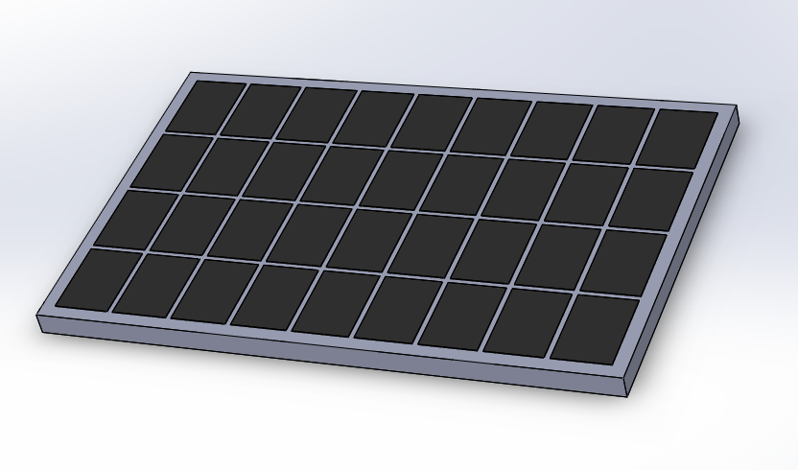
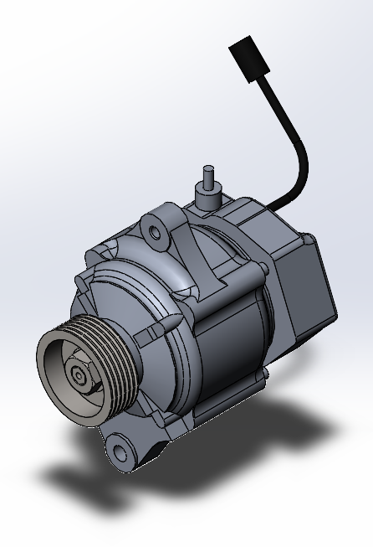
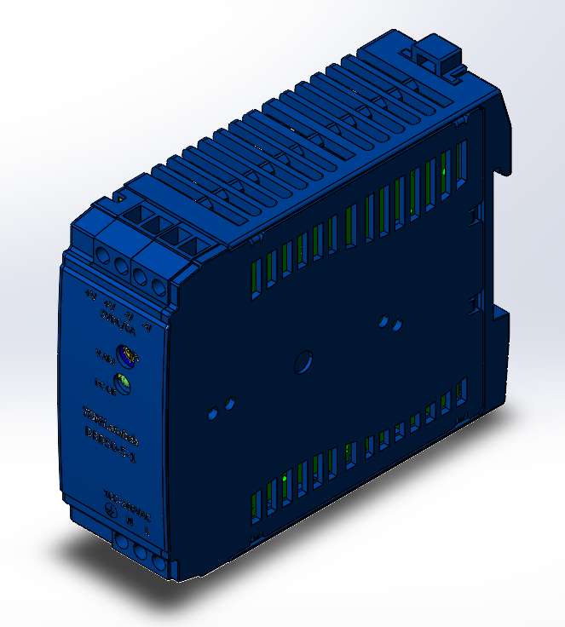
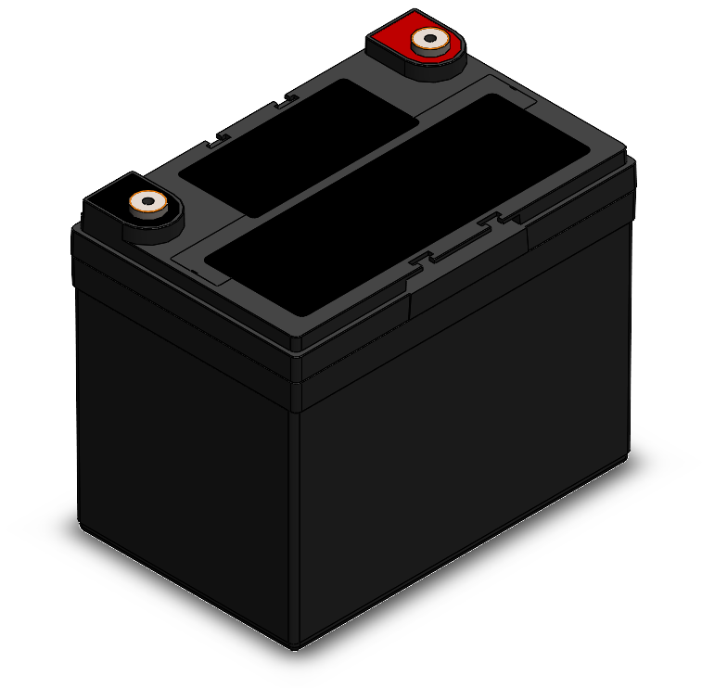
CAD Model
Figure 8: Solar Panel
Figure 7: Thermoelectric Generator
Figure 5: Alternator
Figure 6: Converter
Figure 9: Battery
EV Moghaddam 10/6/21

Slide 15
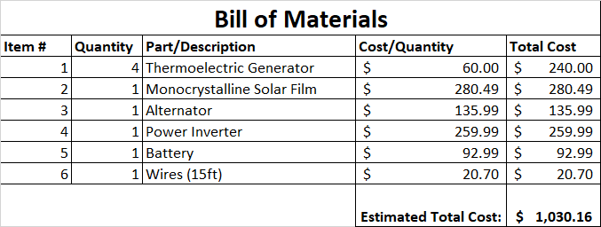
Budget Planning
Budgeting for our final design given that our design is comprised of existing products we see a budget like this:
Remaining $469.84 will be used for prototyping and contingency as needed.
EV Moghaddam 10/6/21
Notes:
Thermoelectric generator [1] - 4 ✕ $60 = $240
Solar Film [2] - $280.49
Alternator [3] - $135.99
Power inverter [4] - $259.99
Battery [5] - $92.99
Wire [6] - 15ft ✕ $1.38 = $20.70
Total estimated cost : $1030.16

Slide 16
Questions?
EV Moghaddam 10/6/21

Slide 17
Works Cited
[1] “Teg1-12611-8.0,” Thermoelectric Generator, 16-Oct-2020. [Online]. Available: https://thermoelectric-generator.com/product/teg1-12611-8-0/. [Accessed: 06-Oct-2021].
[2] “175 watt 12 volt flexible monocrystalline solar panel,” Renogy United States. [Online]. Available: https://www.renogy.com/175-watt-12-volt-flexible-monocrystalline-solar-panel/?gclid=CjwKCAjwzOqKBhAWEiwArQGwaGYaQAtejVbiTtvnsaVuMjNCMdnlTya4M8j8jU6RtPOc4rMlrAhJQBoC4q8QAvD_BwE. [Accessed: 06-Oct-2021].
[3] “Bosch Alternator AL218X,” autozone. [Online]. Available: https://www.autozone.com/batteries-starting-and-charging/alternator/p/bosch-alternator-al218x/1094811_0_0?cmpid=PLA:US:EN:AD:NL:1000000:STR:816128383&gclid=CjwKCAjwzOqKBhAWEiwArQGwaIYy3dHuDiQnnGcz_Hk7hMSgiuG1DEnBxK-BP0EGKXekGAK7OV-XPhoCGEgQAvD_BwE&gclsrc=aw.ds. [Accessed: 05-Oct-2021].
[4] “Power Bright 2300 Watt Power Inverter,” autozone.com. [Online]. Available: https://www.autozone.com/12v-products/power-inverter/p/power-bright-2300-watt-power-inverter/369543_0_0 . [Accessed: 05-Oct-2021].
[5] “Duralast 24MS Group 24 Deep Cycle Marine Starting Battery,” autozone.com. [Online]. Available: https://www.autozone.com/miscellaneous-non-automotive/marine-battery/p/duralast-24ms-group-24-deep-cycle-marine-starting-battery/1006724_0_0?cmpid=LIA:US:EN:AD:NL:1000000:DBA:10620994470&gclid=CjwKCAjwzOqKBhAWEiwArQGwaFQRR9BSzPJtjYUg9IN_4Rxve8WwWbJI9rm_FN-IqxJ1MVpim_s48hoCE_gQAvD_BwE&gclsrc=aw.ds . [Accessed: 05-Oct-2021].
[6] “Southwire (by-the-foot) 4 white stranded Cu Simpull THHN wire-20500599,” The Home Depot. [Online]. Available: https://www.homedepot.com/p/Southwire-By-the-Foot-4-White-Stranded-CU-SIMpull-THHN-Wire-20500599/204724898. [Accessed: 06-Oct-2021].
EV Moghaddam 10/6/21

